Slide 1
Episodic Memory Consolidation
(proposal. I didn’t do this yet.)

Slide 2
Research Goal: learn decontextualized sequences
When would an agent need declarative memory of a decontextualized sequence?
Route recognition
Learning song lyrics
Activity recognition
1
Notes:
When the sequence itself is a generally useful unit of knowledge, you should represent it in SMem.
epmem- It stores context-laden sequences

Slide 3
Goal: Learn general sequences
Example: Jingle Bells (j b j b j a t w)
Try using Spreading with edge weights?
j->b ⅔ j->a ⅓
Unique-element sequences (abc) are a special case!
the current token uniquely identifies the next token.
Spreading Activation with Edge Weights is insufficient!
2

Slide 4
What can we do already?
Functionality
Recall sequences
Learn unique-element sequences (abc...)
Learn general sequences (jbjbjatw)
Mechanism
Spreading (or even just retrieval)
Edge Weights
???
3

Slide 5
How to represent/memorize general sequences?
Option 1 (doesn’t work):
Use existing representation.
Any two successive items have a next pointer with some weight.
4

Slide 6
How to represent/memorize general sequences?
Option 1 (doesn’t work):
Use existing representation.
Option 2 (boring):
Ignore the problem and trivially make the sequence unique. (“Uniqueify” it.)
Instead of jingle bells, have 1,2,3,4,5,6,7,8 where 1, 3, and 5 each have a “jingle” underneath
Or make a different token with some naming rule
Jingle_1, bells_1, Jingle_2, bells_2, ...
4

Slide 7
How to represent/memorize general sequences?
Option 1 (doesn’t work):
Use existing representation
Option 2 (boring):
Ignore the problem and trivially make the sequence unique. (“Uniqueify” it.)
Option 3 (cool!):
Note that repeated symbols allow compression (which in turn can show hierarchical structure)
What??
4

Slide 8
What do I propose?
Functionality
Recall sequences
Learn unique-element sequences (abc...)
Learn general sequences (jbjbjatw)
Mechanism
Spreading (or even just retrieval)
Edge Weights
???
5

Slide 9
What do I propose?
Functionality
Recall sequences
Learn unique-element sequences (abc...)
Learn general sequences (jbjbjatw)
Mechanism
Spreading (or even just retrieval)
Edge Weights
Episodic Memory Consolidation
5

Slide 10
Episodic Memory Consolidation
Entire Agent lifetime is one large general sequence
Use compression to mine out hierarchical structure within the repetition
Jingle bells is a repeated hierarchical subsequence.
Put declarative representation of general sequence into SMem
6

Slide 11
Episodic Memory Consolidation
Easy case:
Off-the-shelf string compression algorithm Sequitur (Nevill-Manning - ‎1996)
Input: “jbjbjatw”
Output: S->AAjatw, A->jb
7

Slide 12
Episodic Memory Consolidation
Easy case:
Off-the-shelf string compression algorithm Sequitur (Nevill-Manning - ‎1996)
Input: “jbjbjatwjbjbjatw”
Output: s->BB, B->AAjatw, A->jb
8

Slide 13
Easy Case
Option 3 (cool!)
Option 2 (boring)
9

Slide 14
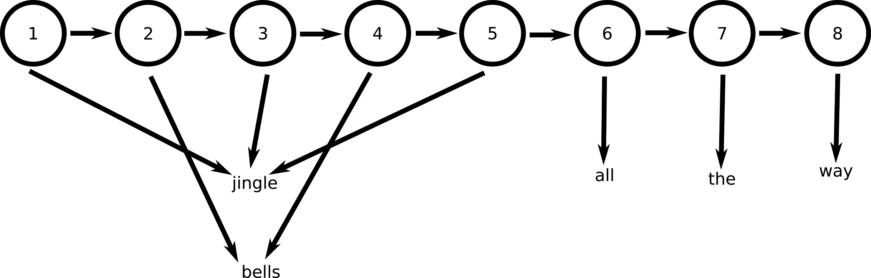
Easy Case
Option 3 (cool!)
Option 2 (boring)
9
Notes:
Merely ends up replicating parts of EpMem store

Slide 15
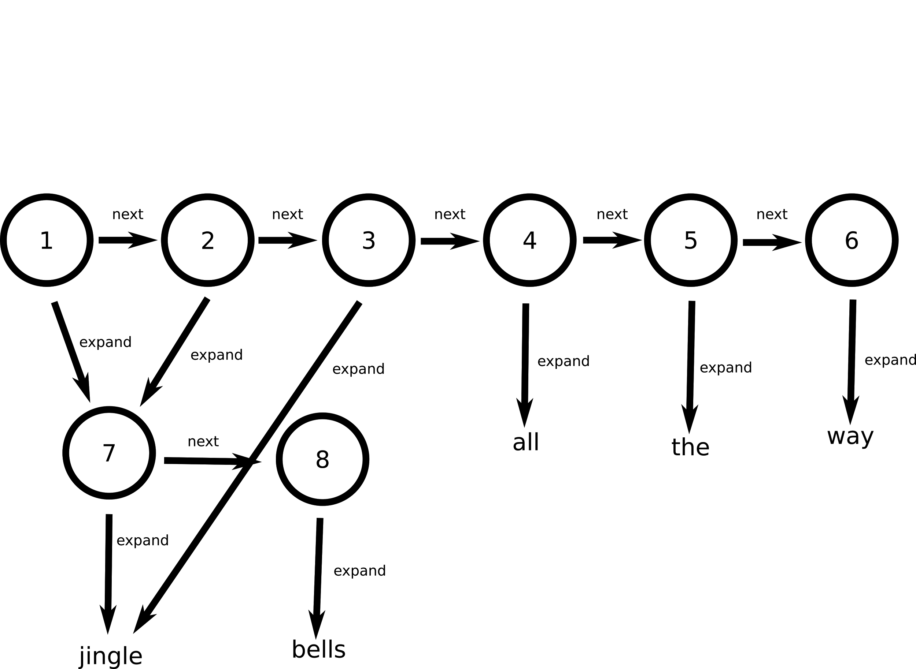
Easy Case
Option 3 (cool!)
Option 2 (boring)
9

Slide 16
Hold on… What?
What I’ve demonstrated:
Automatic storage of general sequences could be done at least with strings
Algorithm exists to isolate common *substrings*
10

Slide 17
What about EpMem? Soar?
Well… I only know the easy way.
Easy way:
At a particular “address” in EpMem’s WM graph, ...
11

Slide 18
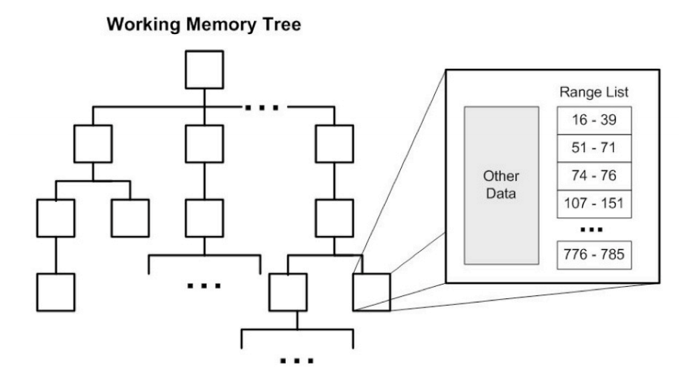
Working Memory Graph
12

Slide 19
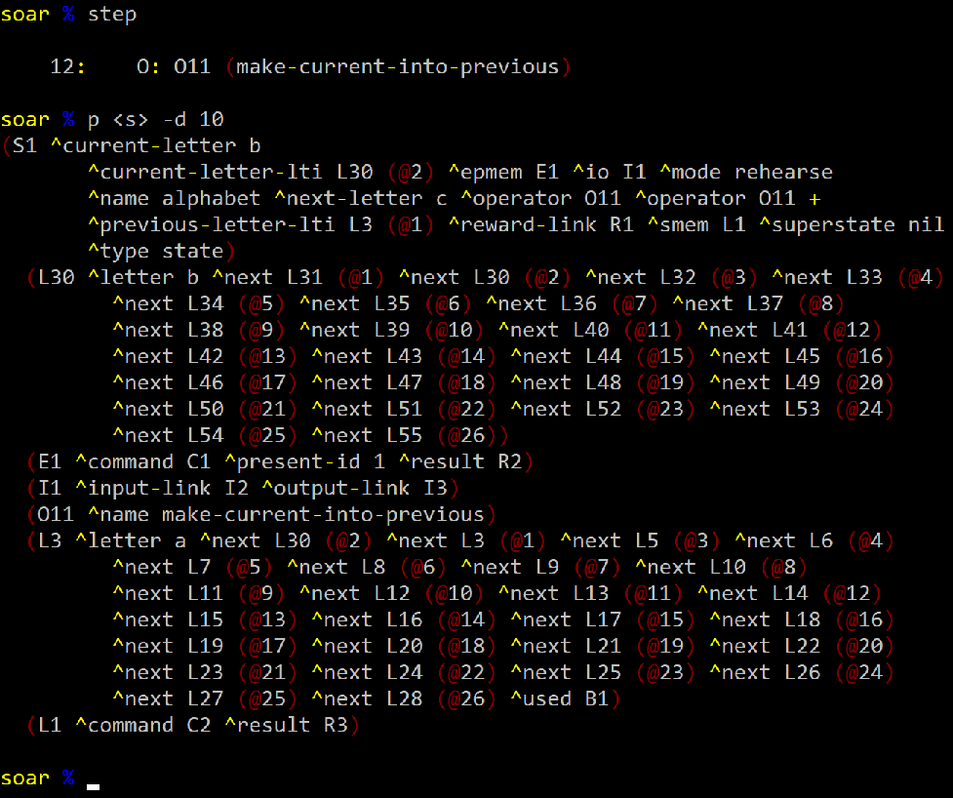
What about EpMem? Soar?
A given “address” in Working Memory Graph (within EpMem) is a sequence of constants and identifiers.
13

Slide 20
How do you make this SMem structure?
Well… I only know the easy way.
Easy way:
At a particular “address” in EpMem’s WM graph, treat the values as a symbol stream. (works easily if nothing but terminals occur at the address) Apply off-the-shelf hierarchical compression.
14

Slide 21
How do you make this SMem structure?
Well… I only know the easy way.
Easy way:
At a particular “address” in EpMem’s WM graph, treat the values as a symbol stream. (works easily if nothing but terminals occur at the address) Apply off-the-shelf hierarchical compression.
Concerns:
What if ids/structure come in? What about noisy/meaningless symbols? What about when the agent wants to change the resulting SMem structures? …
14

Slide 22
What do you think?
Unanswered Questions:
Is this even worth doing? The “boring” Option 2 would technically work.
Side-note: we would get some EpMem compression out of Option 3.
What exactly in Soar is the stream input to be mined/compressed?
I’ve only conceptually worked out the easy case.
How will an agent use this? (New SMem knowledge the rules don’t even know has been made.)
Free recall + spreading would spontaneously recite Jingle Bells if given the start node.
Should I try to approach this from the tensor/graph compression point of view?
Would be about compression of the whole WM tree, not value streams.
15

